Slide 1

Week 5: Transcription and intonation
Ryan Ka Yau Lai
University of California, Santa Barbara

Slide 2

Before we start …
Open sbc007.rez
If you have a file saved from previous classes, please open that
If not, just open sbc007
Also, please go to Google Drive and download unit_anno.json from section materials
And take note of the question + codeword on the board!

Slide 3

Today’s question
Choose around 3-5 intonation units from SBC007, and give me line numbers.
Tell me which IUs are holistic & which are analytic.
Pick one of the holistic IUs, and tell me what it is doing in the conversation.
(You can do this during today’s group activity.)

Slide 4

Let’s talk a little about last week’s assignment …

Slide 5

Misconception #1: Accessibility is about a referring expression’s effect on the recipient
Incorrect: ‘The expression that five-car pile-up is accessible since it is easy to think of the accident after the recipient has heard the phrase’
Correct: ‘The referent, the accident, is not accessible since the surrounding context is not about any accidents so it is difficult or them to think of the accident. So accessibility is low, and a long, specific form was chosen to convey this. ’

Slide 6
Misconception #2: Definite expressions are used to make something identifiable
Incorrect: ‘The expression that five-car pile-up is made identifiable by the definite determiner that’
Correct: ‘The speaker believes that referent, the accident, is identifiable by the listener using the rest of the referential expression (perhaps because they heard it on on TV, etc.). Therefore, an definite expression was used.’

Slide 7
Misconception #3: Meaning of ‘determiner’
Incorrect: I / them are determiners
Incorrect: that thing / two people do not have determiners
Correct: Determiners in English include articles (a, the), quantifiers (some, three), adnominal demonstratives (this, that when they occur next to a noun), possessors (my, its), etc.

Slide 8
Talking about examples: accessibility
Contextual information (gapUnits, physical context, social context …) about how accessible something is
01
High/low accessibility
02
Choice of a referential form to convey that level of accessibility (higher accessibility > smaller, less specific forms)
03

Slide 9
Talking about examples: identifiability
Contextual information (physical context, social context …) about whether the listener expects the speaker to be able to identify something from the referring expression
01
Identifiable vs. not identifiable
02
Choice of a referential form to convey identifiability value (identifiable > definite, non-identifiable > indefinite)
03

Slide 10

The rest of this section is on material that isn’t the focus of this course!
The details will be taught in ling 170
but these concepts will still be useful for your papers

Slide 11
Common transcription conventions
Convention | Meaning
(%) | Glottal release
(H) | Inbreath
(Hx) | Exhalation
@ | Laughter
(TSK) | Tsk-tsk
Convention | Meaning
(.) | Shorter pause
(…) | Longer pause
# | Unclear
[ ] | Overlap brackets
wor:d | Lengthening

Slide 12
Intonation units (IUs)
The ‘units’ we’ve been talking about in this course so far represent intonation units
‘A short burst of speech’
Intonation units are used to package information & connect different parts of discourse

Slide 13
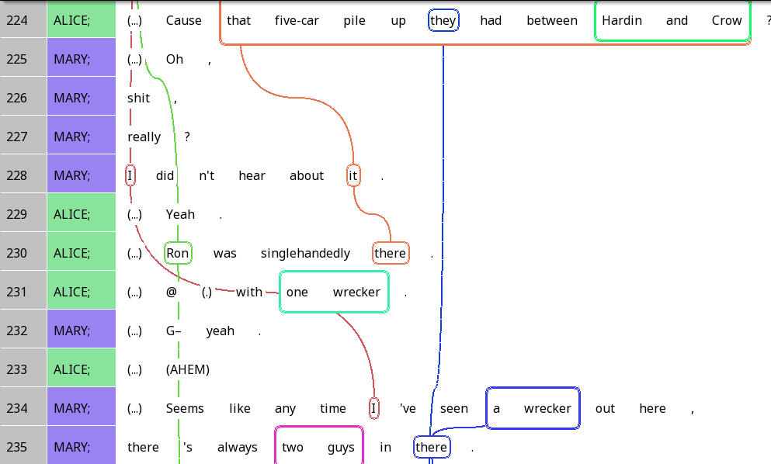

IUs: packaging information

Slide 14
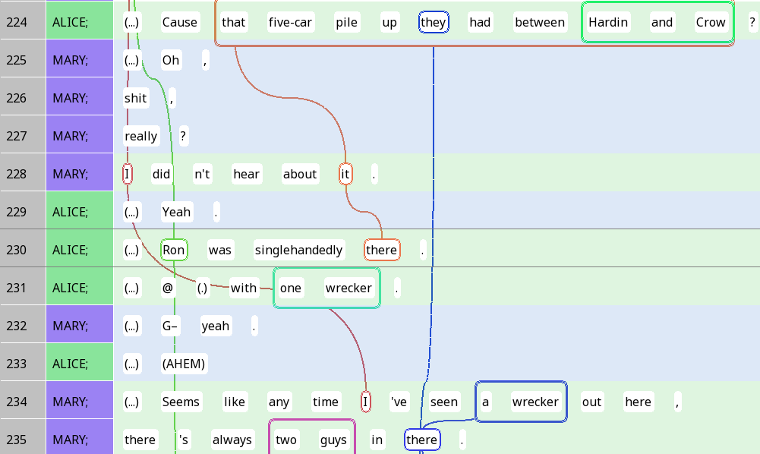
Holistic (regulatory)
Integrative (substantive)

Slide 15
Holistic IUs: Interjections, ‘discourse markers’ …
Holistic (regulatory)

Slide 16
Integrative IUs: ‘One new referent per IU’ tendency
Integrative (substantive)

Slide 17

Adding a new tag scheme
Please go to Google Drive and download unit_anno.json …

Slide 18

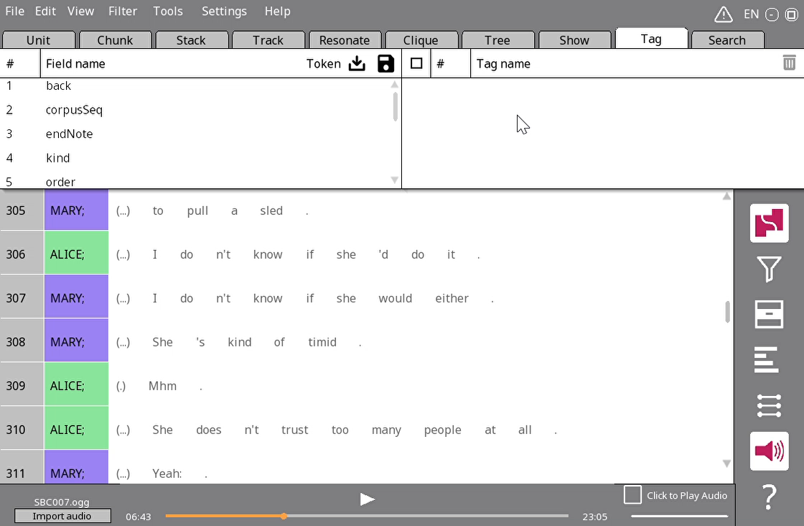
Adding a tag scheme
Go to the Tag tab in the nav window
Click on the load icon
Navigate to your unit_anno.json file and select it (not shown in video)
Change the Token next to to unit, and check that your Unit has two new fields: unitType and numNewReferents

Slide 19
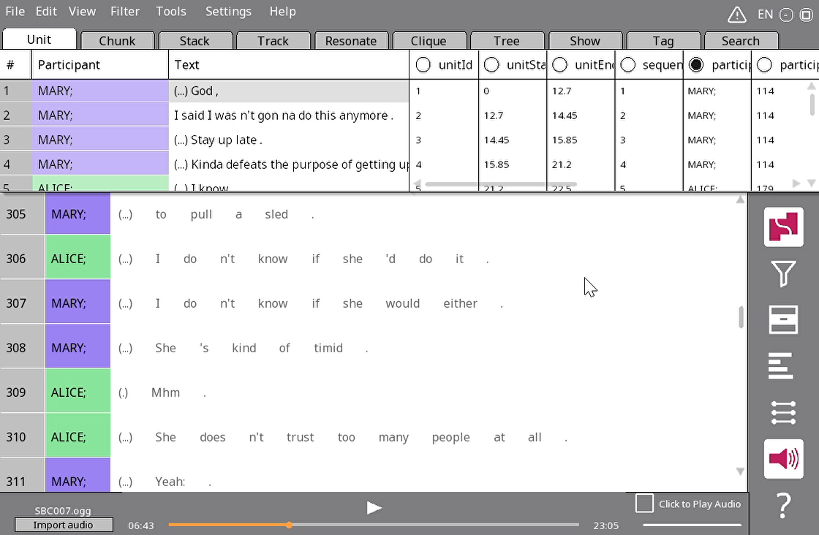

Changing visible columns
Change to one-to-one mode
Navigate back to the Unit tab
Click on the unitStart column name, click Select field and choose numNewReferents
Similarly, change unitEnd to unitType

Slide 20
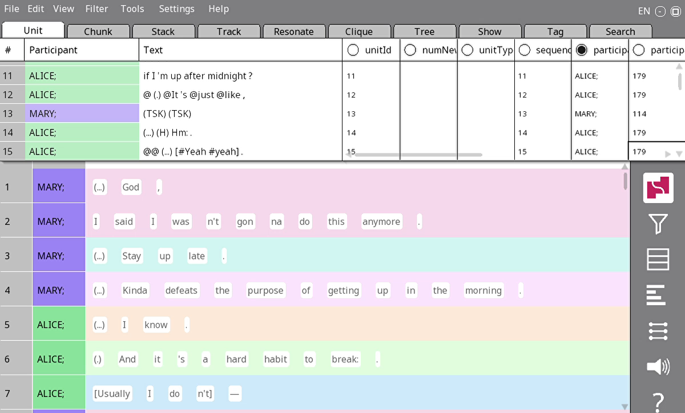

Annotating numNewReferents and unitType
For unitType, just click on the three dots and choose holistic/integrative
For numNewReferents, click on the cell and type (just like you would do in Excel)

Slide 21

Your turn!
Choose 20 lines from the text – preferably, some places where you already have trails
Annotate their unitType (holistic vs integrative)
Annotate the number of new referents per unit
What patterns do you see?
NB: You can do your attendance question based on these.

Slide 22
Four types of endnotes
,
Continuing (‘comma’, stable)
?
Appeal (‘question mark’, rising)
.
Terminating (‘period’, falling)
--
Truncation (‘dash’, when you feel the IU was not finished)

Slide 23
Continuing intonation - stable

Slide 24
Appeal (question) intonation - rising

Slide 25
Terminating intonation - falling

Slide 26
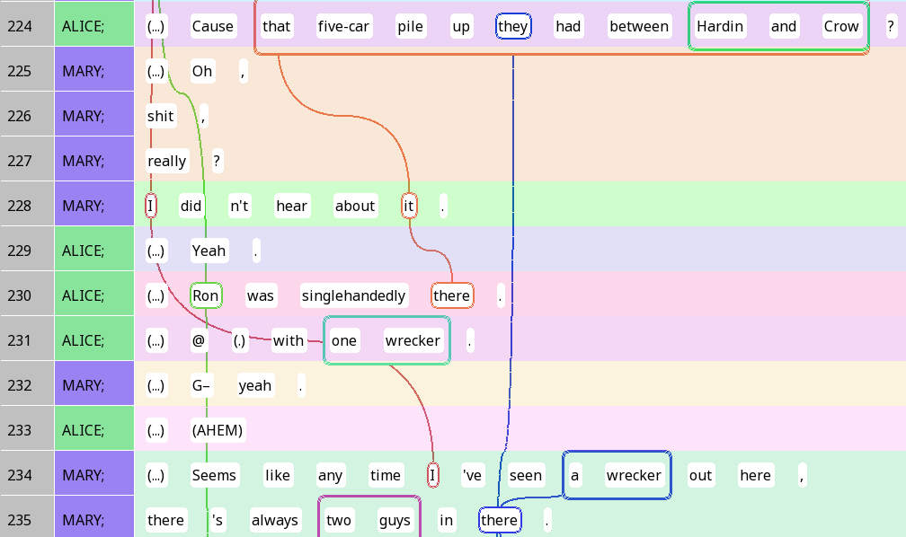
Prosodic utterances
Continuing intonation: We’re not done yet
Appeal/Terminating (closure): We’re done with this point

Slide 27
Prosodic utterances & ‘sentences’
Are prosodic utterances equivalent to sentences?

Slide 28

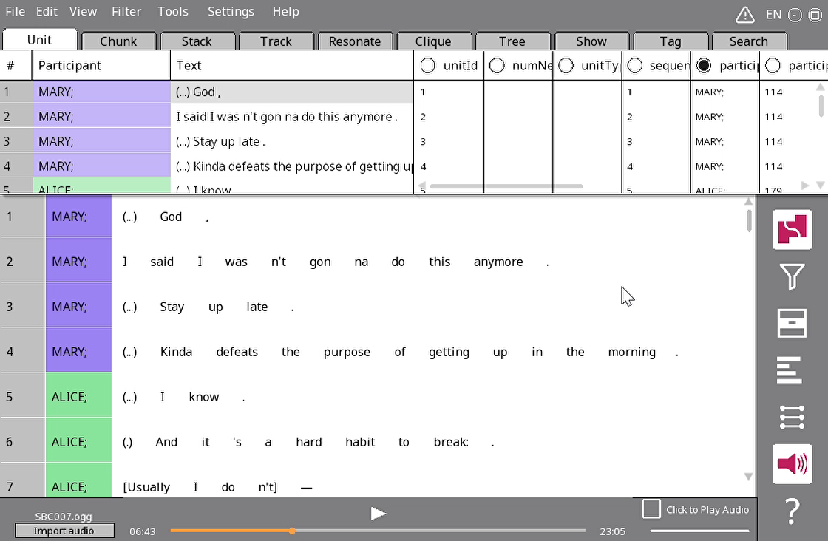
The utterance stacker
Open SBC002
Tools > Stacker > Utterance
Click OK
Wait a few seconds
Each stack is now a prosodic utterance

Slide 29

Q&A time – Identifiability & accessibility

